Slide 1
Wascosa – Freight Wagon Systems
Meeting at MVMS
Peter Balzer, CEO Wascosa AG
Budapest, 25 November 2016
Notes:
Dear Members of the Hungarian Private Wagon Association
It’s a great pleasure and I’m very thanksful to have the opportunity to present Wascosa to you today.
As part of our defined development strategy we decided to provide products and services from to the freight rail market in Hungary.
Ist our strong willingness to be an attractive new alternative to existing Lessors portfolio in Hungary.

Slide 2
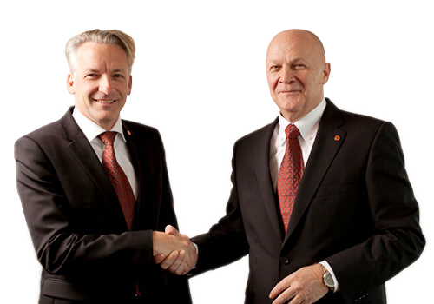
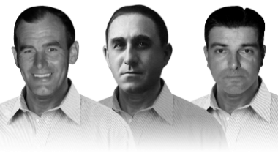
A 2nd generation family company
1964
today
Pioneer in the industry
Founded 1964 from Jakob WAelti, Pietro SCOtti and Max SAndmeier
Managed by Philipp Müller-Sandmeier, President of the board of Directors and Peter Balzer, CEO
Notes:
The picture shows the changes we have made in the last 50 years.

Slide 3
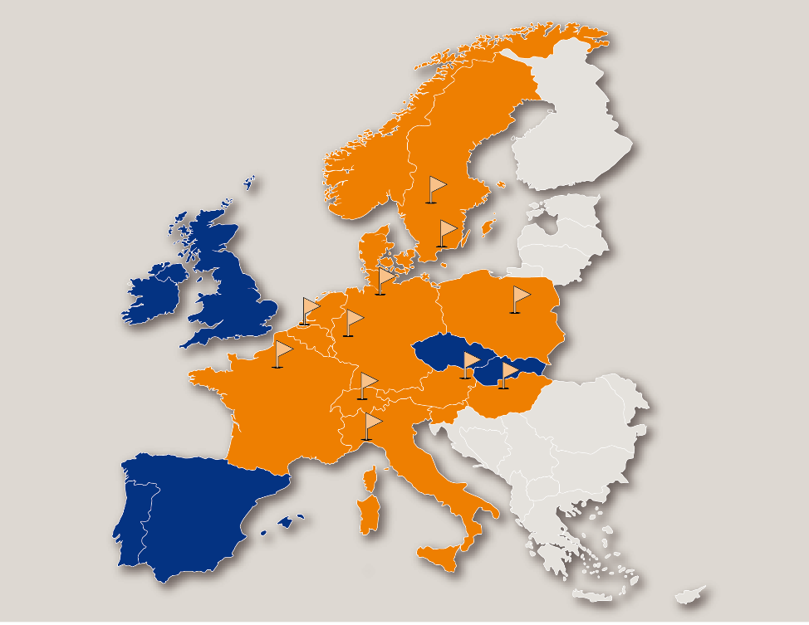
Europe-wide locations
Our location:
Headquarter in Lucerne, Switzerland
Exklusive Sales Partners:
Germany and Austria
Benelux
France
Italy
Poland
Scandinavia
Hungary
Sales Partners under development:
Great Britain
Spain / Portugal
Czech Republic / Slovakia
Notes:
Orange ist the dominant color and shows the markets where we have exklusive sales partners, means we provide all our product and services to the customers
The blue color shows the markets where we are nearly to complete our homework.

Slide 4
Dynamic growth
No. 6 leasing company of rail freight cars in Europe
Today: 8’000 freight cars
Wascosa fleet of cars: Year end inventory
Notes:
Growth is a key of our business strategy but not with the aim to be the largest, no but to be the fastests. It’s clear in a market where consolidation is process it’s for us a necessity also to grow to keep and extend our position.

Slide 5
Development and progress
1964
Foundation
1995
ISO 9001
2002
Wascosa euro tank car
2009
Wascosa flex freight system / Innovation Award
2013
Recommended by CEFIC
1973
Expansion
1998
Derailment Detectors
2007
Foundation CRSC
2011
Wascosa Safety Day
2014
50th anniversary,
first system provider
1969
The fleet grows
1996
Wascosa goes online
2003
Wascosa infoletter
2010
Wascosa safe tank car
2015
Covered hopper cars
1993
The new generation
2000
ICT platform
2008
Intermodal wagons
2012
Move to Lucerne / ECM 445/2011
Notes:
This slide shows you some highlights of the last 52 years of Wascosa from birth to now.
What you can expect from us is a lot of experience and a lot of good products and services for the freight car market. I kindly ask you to use it.

Slide 6
Our customers
Notes:
This is a part of our customer portfolio. We are proud to serve so many customers and hopefully more new to come.
We like to serve the customers.

Slide 7
Organisation
Philipp Müller President of the Board of Directors
Peter Balzer CEO
Detlef Schlickelmann Chief Operations Officer
Thomas Lippuner Chief Sales Officer
Fabian Stadler Chief Financial Officer
Irmhild Saabel Chief Business Development Officer
Notes:
We are orginzed with a line structure ready for purpose and built based on many Experts from the rail freight business. Quality and competences of our staff is an important cornerstone of our success.

Slide 8
Our concept
Focus on innovative solutions in safety and efficiency
Focus on independency and value-based growth
Focus on customer
Notes:
Our concept is simple as you can see focused on a few areas where we demonstrate our total committment.

Slide 9
Our business areas
Renting of cars
New build projects
ECM fleet management
System Provider for freight wagon systems
Notes:
Looking to the business strategy we are focused in 4 areas.
These are the 4 stratgic pillars where we want to be best in class and here not in quantity but in quality.

Slide 10
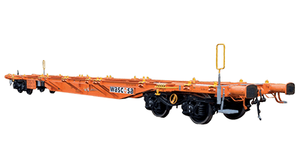
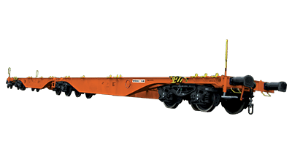
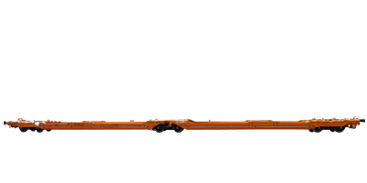
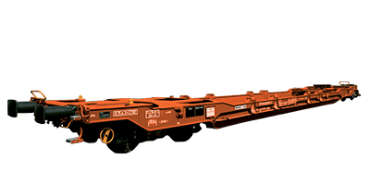
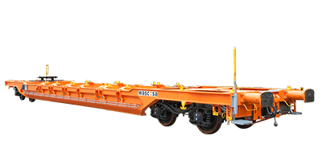
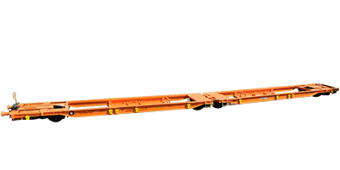
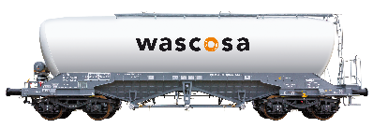
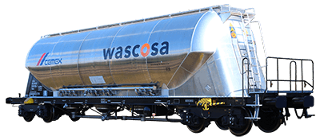
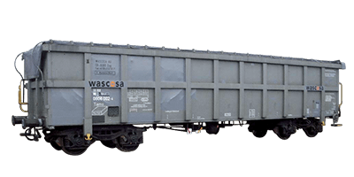
Our car fleet
Tank Cars
Intermodal Cars
Powder Product Cars
Hopper Cars
Box Cars
Innovations
Notes:
As you can see our wagon portfolio is broad and modern.
The drivers for further development of our portfolio are: Safety and Efficiency.

Slide 11
Our number 1 position
Lesser with the most up-to-date rail car fleet in Europe
50% of the cars are 5 years or younger
The average age of our cars is 12,9 years
Notes:
Looking to the age of our fleet we can say that we have the most up-to-date rail car fleet from all Lessers in Europe

Slide 12
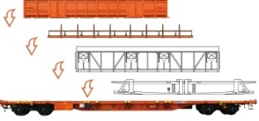
Our success: Innovation
Wascosa euro tank car®
Wascosa flex freight system®
Wascosa safe tank car®
Wascosa Hopper cars
Notes:
Innovation is an important engine of wasocsa for new solutions and one of the reason why we could expand step by step our market share.
Many customers are looking for new ways to improve the efficiency and safety of its logistics processes. And here we want to be the preferred partner.
The safe tank car concept was the most successful product we could develop and implement in the last 10 years but also the new innovative and light hopper cars but also the flex freight system concept which split the cars in underframe and structure could be succesfully implemented in the last years.
And more will come, you can be sure….innovation in safety and efficiency are our oxygene for new solutions.

Slide 13
Wascosa safe tank car®: the new standard
Optimized safety with dangerous goods transportation
Almost 1'000 cars ordered or in the field in 8 different european countries
Notes:
Here you can see how broad the safe tanc car can be used for all the different products more dangerious or les dangerious. We are proud that the market means the customers accepted this type of car as a new standard.

Slide 14
Leading in noise reduction
100%
95%
Wascosa
72%
60%
61%
23%
Average of private freight wagon lesser (UIP)
Quelle: UIP
Notes:
Noise reduction was always our priority. the orange line shows the process of retrofitting our cars to low noise. The blue line is the average of private freight wagon lessers.

Slide 15
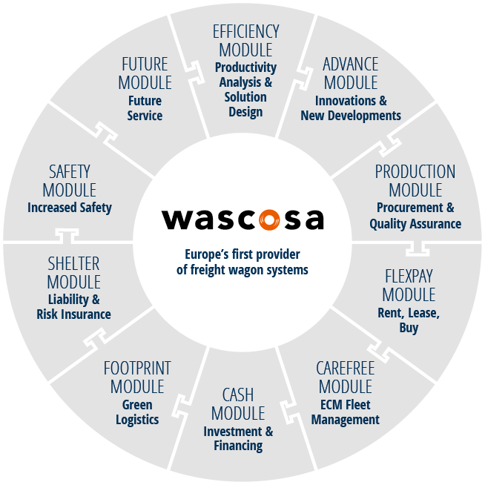
Our uniqueness
Away from the idea of a classic wagon lesser towards ...
Europe’s first provider of freight wagon systems.
Notes:
But what makes us unique and really different is our positing and our willingness to shift our positioning away from the classic wagon lesser towards the provider of freight wagon systems. The wheel resp. the system you can see on the picture contains 10 modules. Each module includes products and services to cover the market demand and to serve the customers in the best and most efficient way.
Depending on the time I will explain some examples:
e.g.
our efficiency module here we provide services such as productivity workshops where we can analyse existing wagon portfolios together with customers to find new efficiency improvements to reduce finaly the logistic costs.
Or
Carefree module which is a ECM service pakage for all shippers or other companies who owns wagons but won’t make the maintenance of those cars by themselves. «you run the business we take care about your wagons».
Etc.

Slide 16
Our long term commitment to Hungary
Support of Hungary Rail Market to implement new, innovative, safe and efficient freight wagon systems including cars and services.
To build up good relationships with many customers and suppliers in Hungary.
To act locally and to process globally:
Sales Representative located in Hungary - local contact to customers and main suppliers
Partnership with Kaminski for spare parts management and heavy maintenance for wagons and wheel sets
Partnership with Total Care Wagon Management Hungary for Mobile Services
Further partnerships with other suppliers are planned
Centralized process administration in Switzerland (Lucerne)
Attractive new alternative to existing Lessors portfolio in Hungary
Notes:
And here is my most import slide and the key message I would like to deliver:
Our long term commitment to Hungary.

Slide 17
Árpád Szűcs
Árpád Szűcs has been working in the field of freight wagon rental for more than 35 years. He started his career with Masped in Hungary, and moved later to Austria.
Although he could retire at the end of this year, he will start with his role as agent for Wascosa in Hungary as of January 2017.
Notes:
Every business is a people business. Only with he best people you can deliver what you promise.
I’m very happy that Arpad Szücs, with 35 years of experience in the freight car market in Hungary is strengthening our new Sales team in Hungary.
Arpad was already retired but as you can see not tired, that’s why we are very thanksful that Arpad is our new representative of wascosa in Hungary from 1 January 2017.

Slide 18
WASCOSA AG
Werftestrasse 4 · 6005 Luzern · Schweiz
T +41 41 727 67 67 · F +41 41 727 67 77
info@wascosa.ch · www.wascosa.ch
Notes:
I come to end of my presentation. I thank you very much for your attention and I will look forward to work closely together with you.
If you have any questions It will be a pleasure to answer.
Once again many thanks.

